Slide 1
SECURE DATA HIDING IN IMAGES USING STEGANOGRAPHY
CAPSTONE PROJECT
Presented By:
Student Name : Umesh Suthar
College Name & Department : Jspm University Pune , B.tech (Cse)

Slide 2
OUTLINE
Problem Statement : Secure Data Hiding In Images Using Steganography
Technology used : Least Significant Bit (LSB) Modification, Encryption Algorithms (Like AES)
Wow factor : Secretly Embed Messages In Plain Sight Within Images
End users : The End User Of Steganography Technology Can Be Individuals, Organizations
Result : Embedding And Retrieving Secret Messages Within Images
Conclusion : Provides Covert Data Hiding And Enhanced Privacy
Git-hub Link : https://github.com/umeshmankad13/project-aicte.git
Future scope: Advancements in algorithms and new applications in digital security

Slide 3
Problem Statement
Steganography is a method of securely hiding data within images by modifying pixel values, often using techniques like Least Significant Bit (LSB) modification. It can involve encrypting the data before embedding it, enhancing security. The hidden data is then extracted by reversing the embedding process. This technology is used for secure communication, digital watermarking, and protecting intellectual property.

Slide 4
Technology used
Steganography utilizes technologies like Least Significant Bit (LSB) modification to embed data within image pixels. It often includes encryption algorithms (such as AES) to secure the hidden data.
Libraries :
CV2: open-cv2 is used for computer vision tasks and image processing.
OS: This module provides a way of using operating system-dependent functionality like
reading or writing to the file system.
String: This module contains a collection of string operations and constants.
IDE
Pycharm

Slide 5
Wow factors
steganography lies in its ability to embed secret messages within ordinary images, making the data invisible to the naked eye. This technology transforms everyday images into covert communication channels, ensuring data privacy and security. The seamless integration of encryption enhances its effectiveness, making steganography a powerful tool for secure and covert data hiding.

Slide 6
End users
The end user is typically an individual or organization that requires secure and covert communication. This could include cybersecurity professionals, intelligence agencies, journalists, or anyone needing to protect sensitive information from unauthorized access. The end user benefits from the ability to hide messages within images, ensuring data privacy and security during transmission

Slide 7
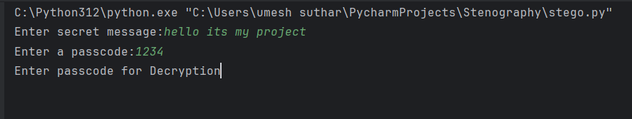
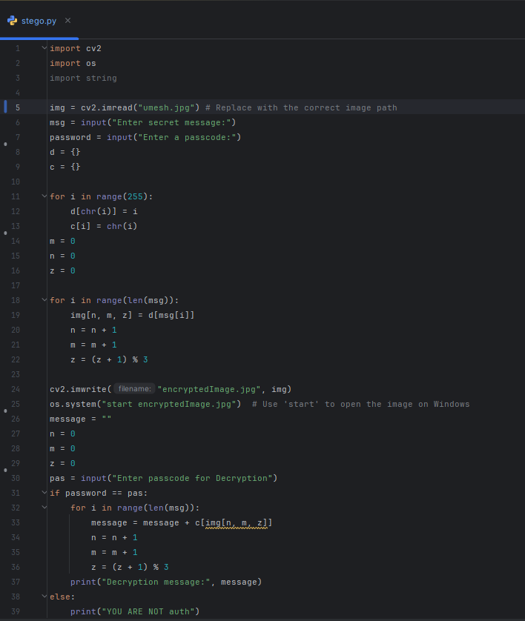

Results
Run environment
Source code
Output

Slide 8
Conclusion
Steganography offers a powerful and covert method for secure data hiding, transforming ordinary images into secret communication channels. By seamlessly integrating encryption and data embedding techniques, it ensures the privacy and security of sensitive information. This technology is invaluable for individuals and organizations needing to protect their data from unauthorized access.

Slide 9
GitHub Link
https://github.com/umeshmankad13/project-aicte.git

Slide 10
Future scope(optional)
The future scope of steganography includes advancements in algorithms for higher security, integration with blockchain technology for traceability, and new applications in digital rights management and secure data sharing

Slide 11
THANK YOU

